Slide 1
Trip Budget java
Class: B1B Software Development.
Professor: William Ruben
Student: Santos Lozano

Slide 2
ABOUT THE PROGRAM
This program was created to make a simple calculation of a budget when planning a vacation.
Program is a public class, meaning is available to anyone.
Program is very user friendly.
The program can run in any (IDE) integrated development environment that supports Java.

Slide 3
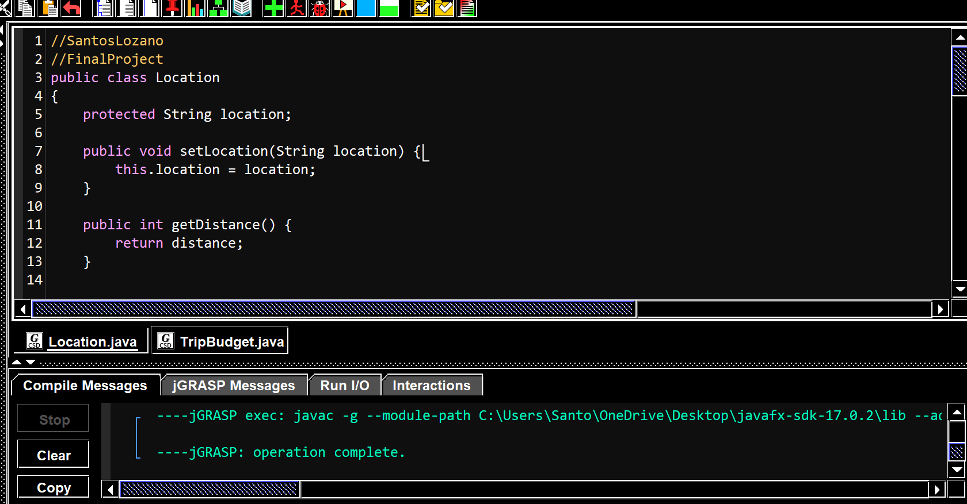
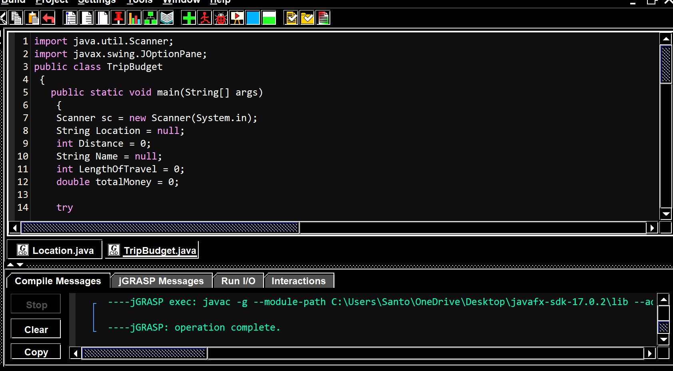
Getting started
Must open both files and compile

Slide 4
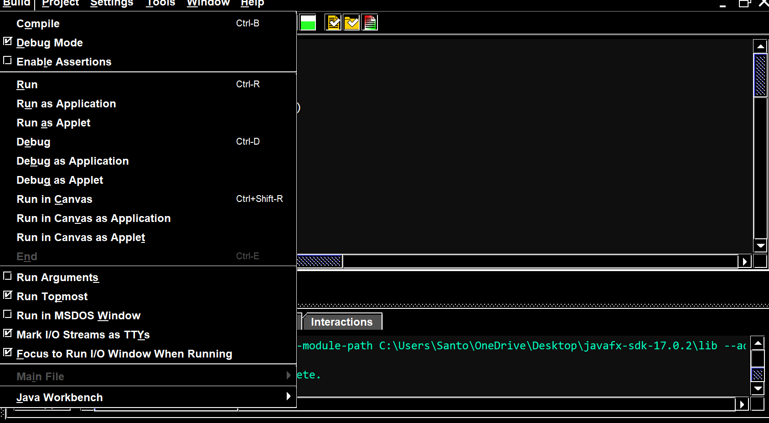
Starting the program
Click build then compile.
Next build then click run

Slide 5
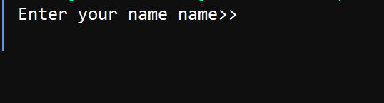
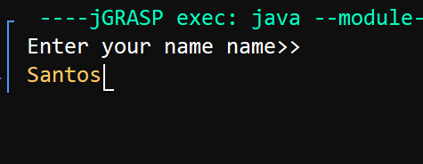
Adding a name
Program will ask you to enter
Your name.
Once your name is entered it will
Display it. Press enter for next question

Slide 6
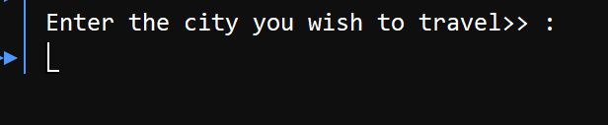

Adding a vacation destination.
Program will ask for user too enter destination.
Once entered it will display destination. Press enter next.

Slide 7
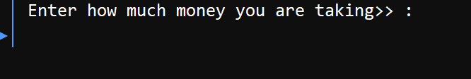
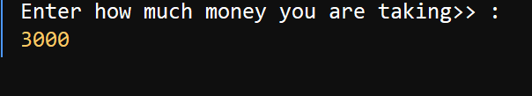
Adding total money planned for trip.
Program will ask you to enter the amount of money you are planning to take.
Once entered it will display it . Press enter next.

Slide 8


Adding the distance
Program will ask you to enter milage. Please enter in numeric format
Once entered program will then display number entered. Press enter next.

Slide 9

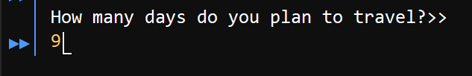
Adding days of stay.
Program will ask you to enter a number of days, please enter a numeric format.
Once entered please press enter.

Slide 10
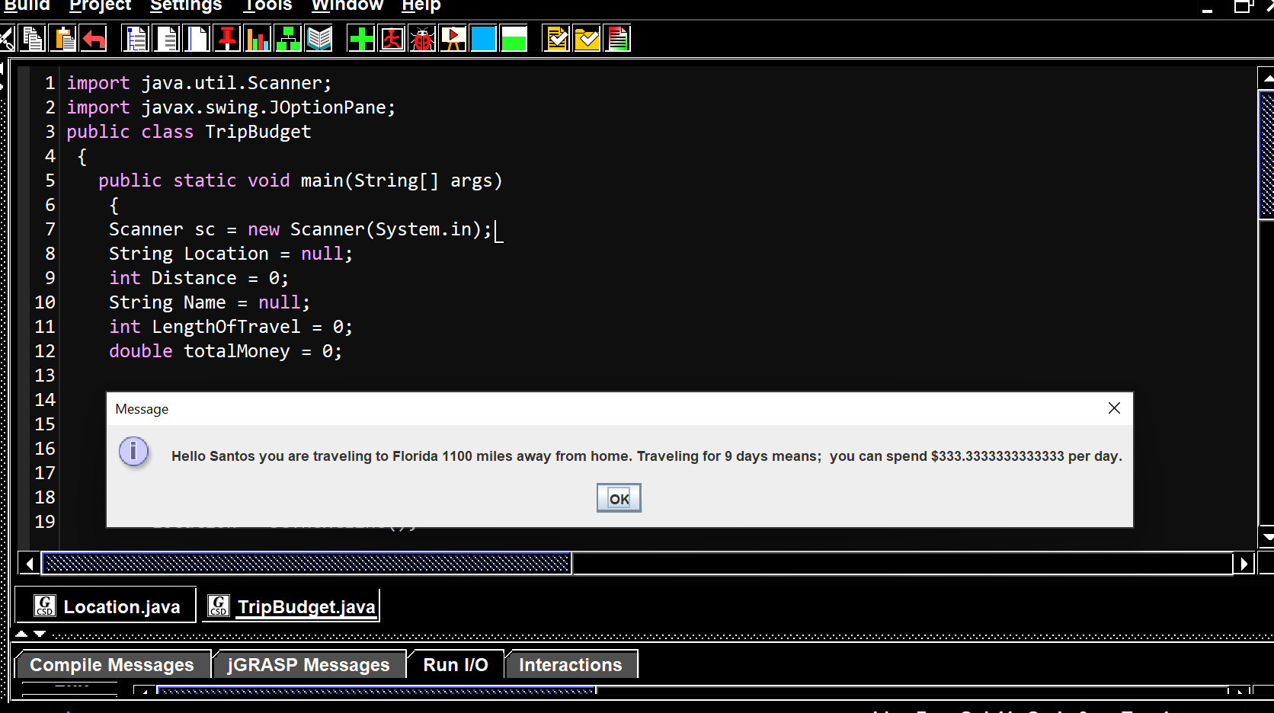
Final output message will be display in a dialog box showing the amount of money you can spend per day and how far a way your destination is from home.

